Slide 1
936 grams of awesome
Challenges of building our own home router
Tomaž Zaman

Slide 2
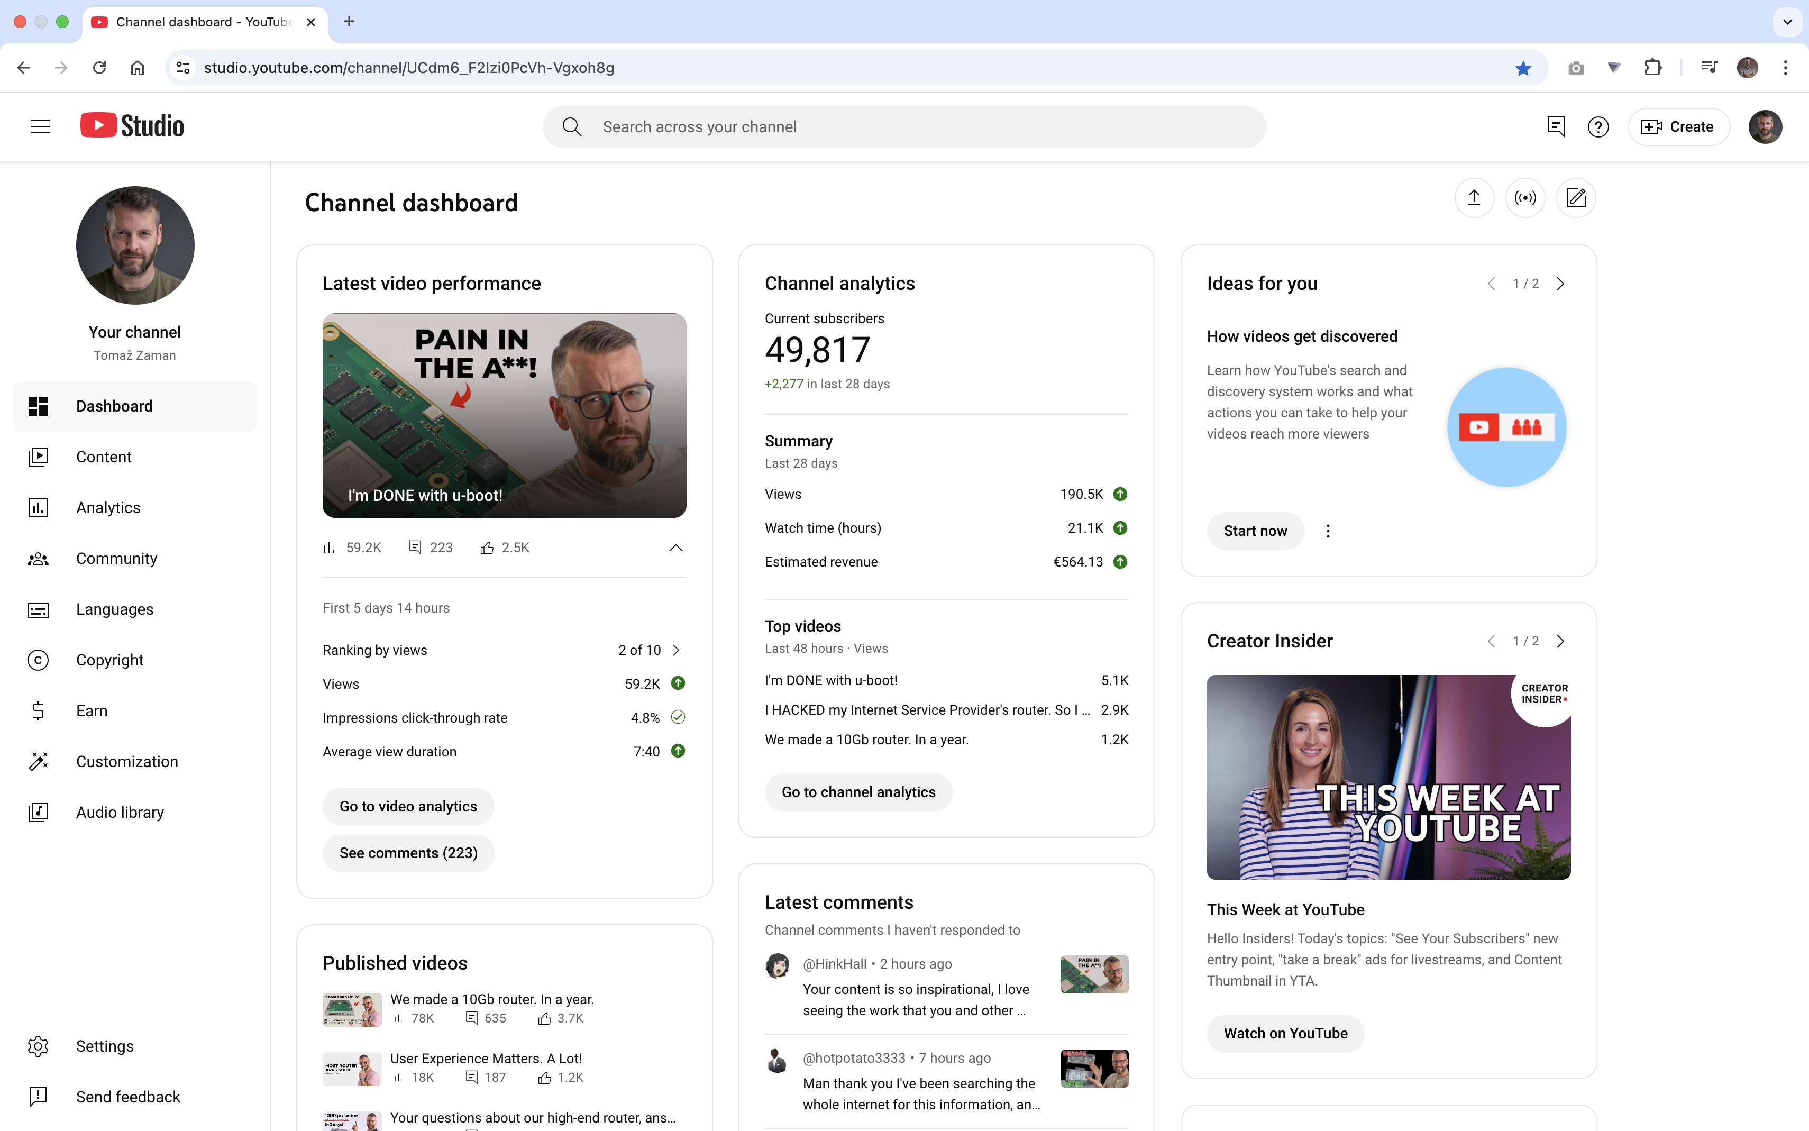

Slide 3
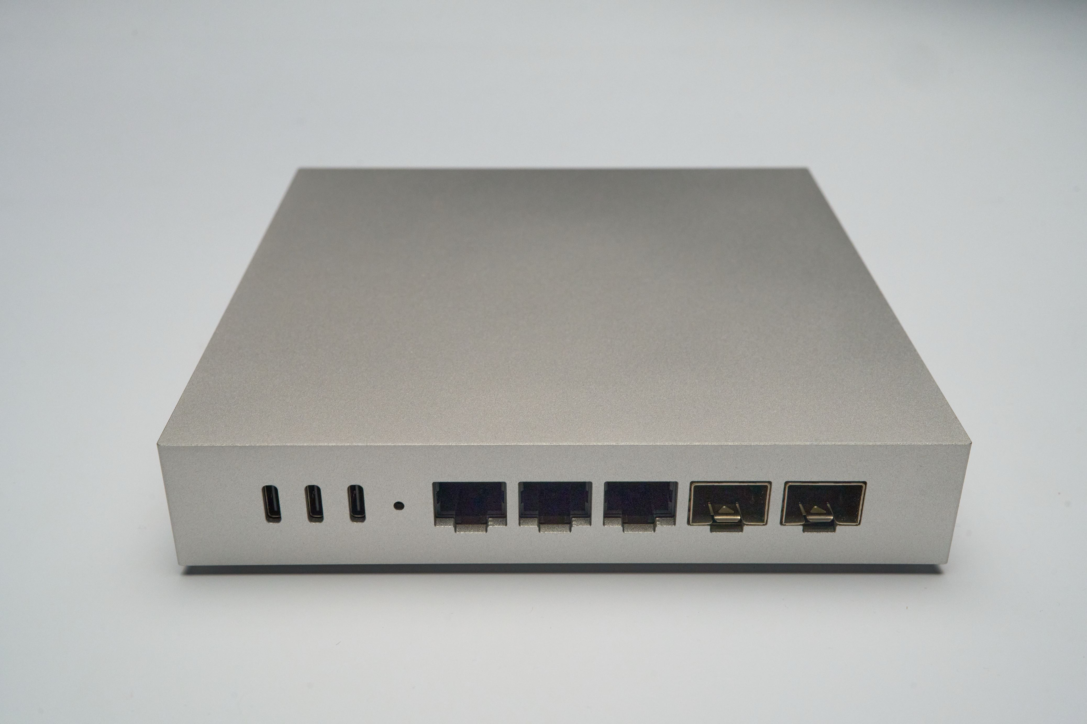

Slide 4
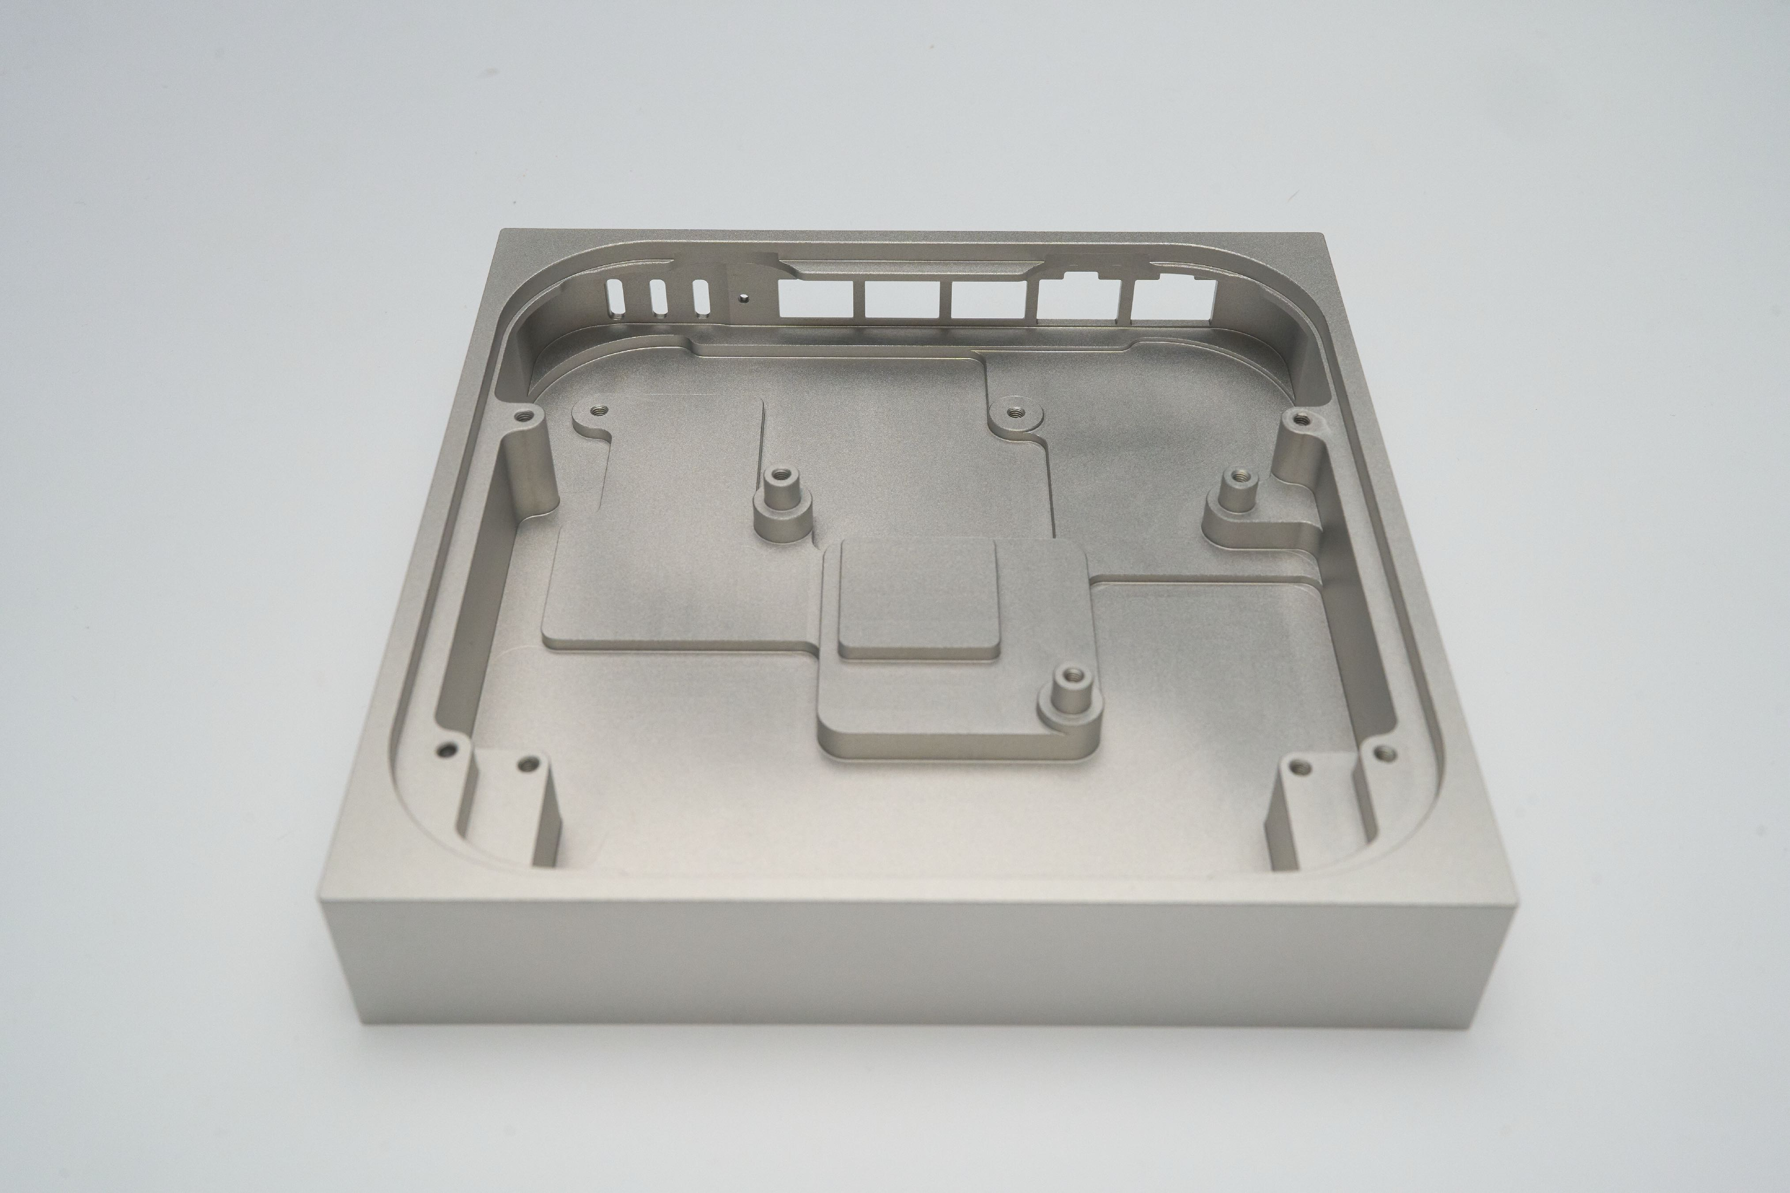

Slide 7
No. Root. Access.

Slide 10
F*ck it, I’ll make my own.

Slide 11
x86 vs. ARM64

Slide 12
X
x86 vs. ARM64

Slide 13
NXP vs. Marvell

Slide 14
X
NXP vs. Marvell

Slide 15
10 Gigabit
At least two ports

Slide 16
NXP LayerScape LS1046A
Perfect choice for ~$70
2 or 4 cores
Up to 16 GB of RAM (with ECC support)
6 Gigabit interfaces
2 10 Gigabit interfaces (!)
1 PCIe lane (3.0)
But most importantly…

Slide 17
Hardware offloading!

Slide 18
LS1046A HW offloading
“Regular” traffic
PPPoE
VLAN
NAT
IPS/IDS (with some limitations)

Slide 19
Form factor: nano-ITX (12 x 12 cm)

Slide 20
Form factor: nano-ITX-ish

Slide 21
Small PCB realestate
For the amount of functionality we wanted
2 SFP+ cages
3 RJ-45 ports
USB power delivery
UART/console
8 GB of ECC RAM
NOR + NAND for bootloader and OS
M.2 ports for wireless support
Battery socket

Slide 23
SFP+ needs a retimer + clock

Slide 25
RJ-45 ports need magnetics + PHY

Slide 27
Solution: standoffs!

Slide 28
USB Power delivery

Slide 29
8 power supplies
USB PD (20 V -> 5 V)
3.3 and 1.8 V for ICs
2.5 and 1.2 V for RAM
1 V for core
1.35 V for SERDES

Slide 31
Oh, the memories…

Slide 32
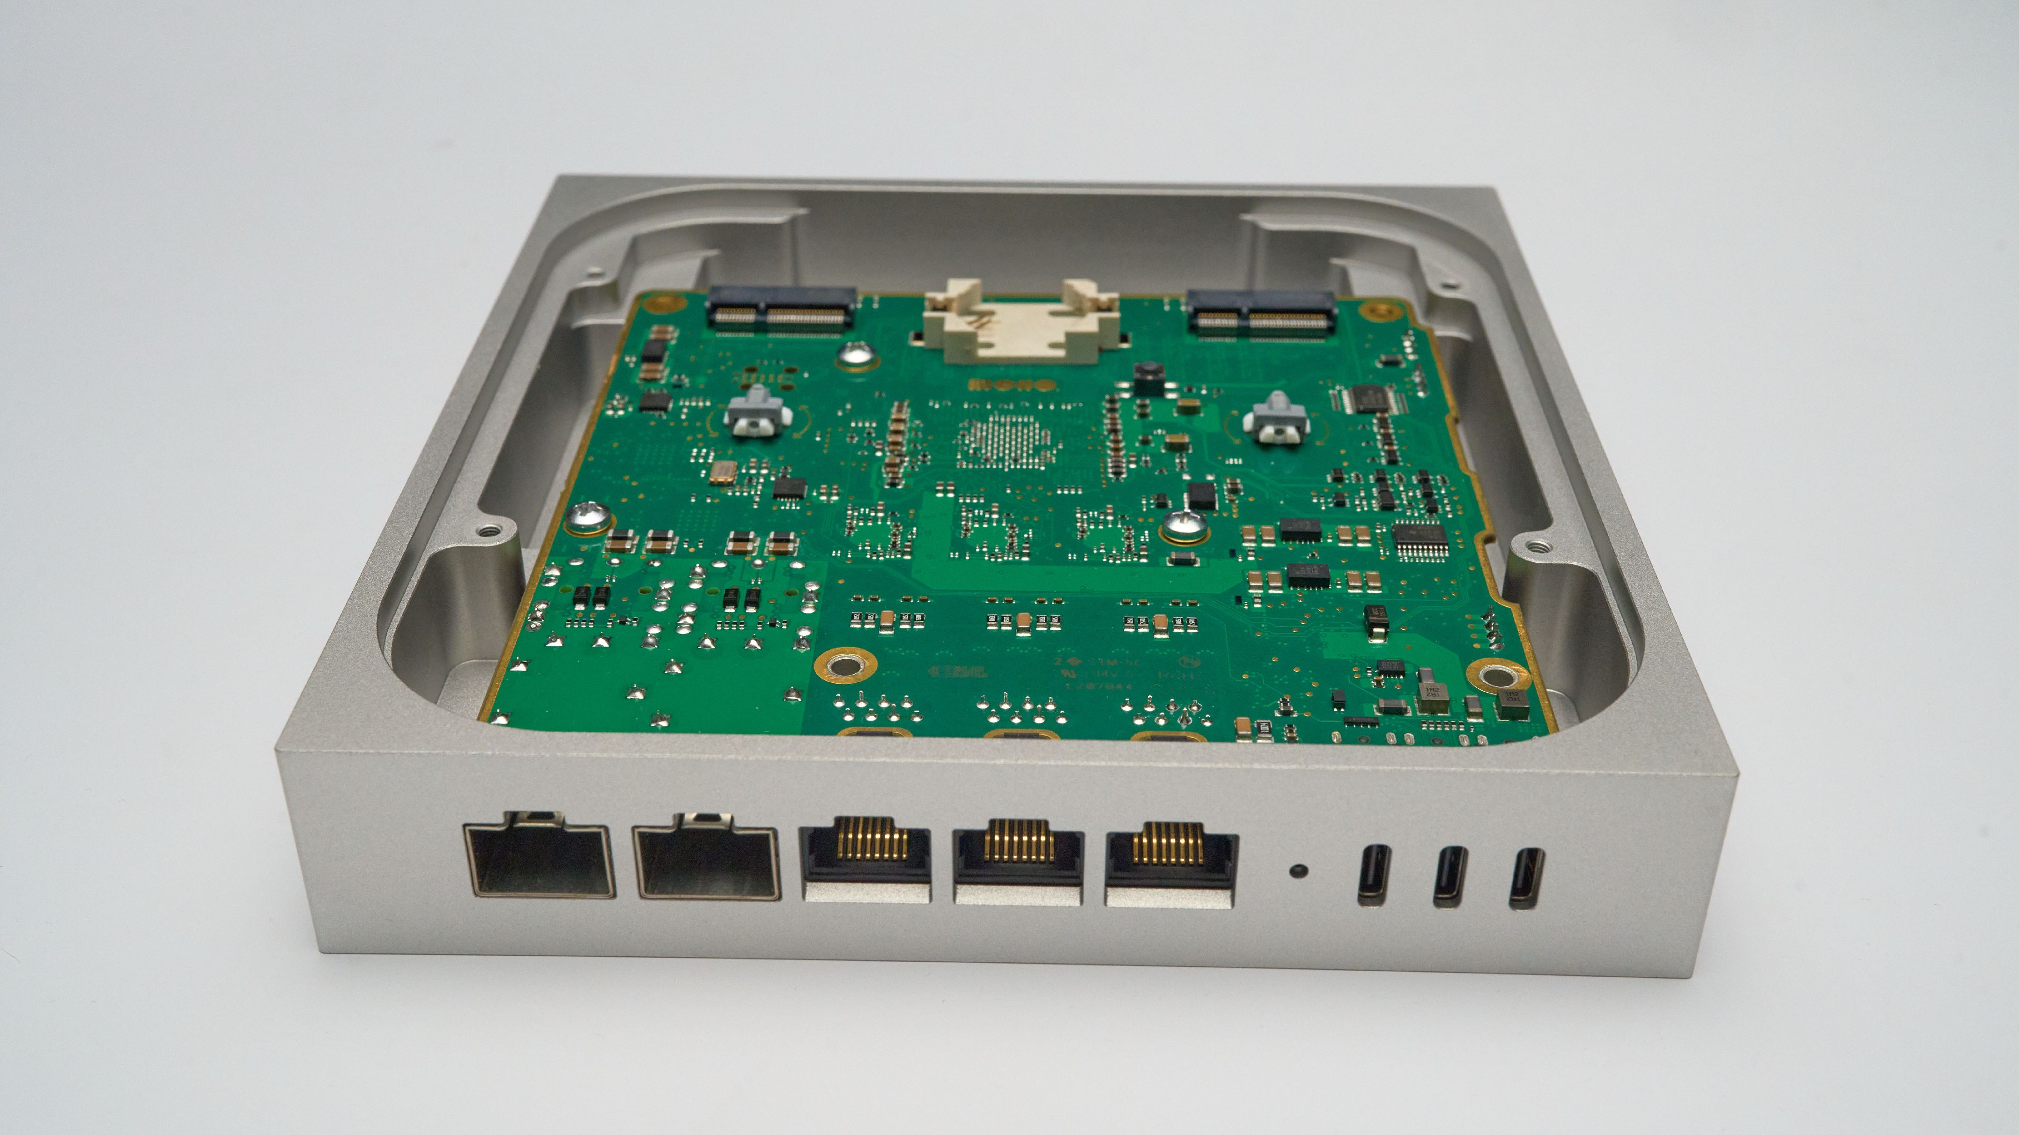
Battery + M.2 connectors

Slide 33
User experience matters! A lot!

Slide 34
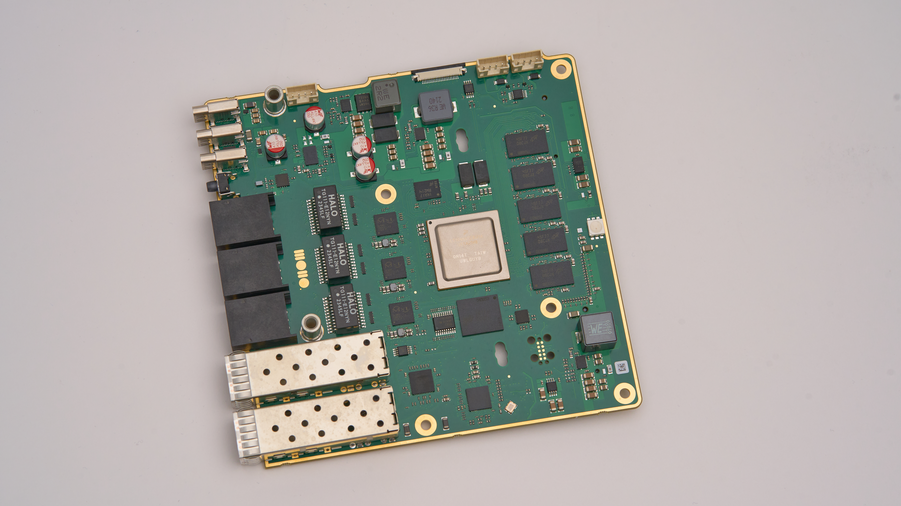

Slide 36
RAM.

Slide 37
What about networking?

Slide 38
Open source
Needs a lot of work
OPNsense and pfSense optimised for FreeBSD
OpenWRT made for resource-constrained devices
VyOS has no GUI
UbiqutiOS is not open source
DPDK + VPP is very complex

Slide 39
WordPress

Slide 40
Future plans
to make it awesome
Finish bringup
Finish the enclosure
Make MVP (with OpenWRT for start)
Build a community

Slide 41
Like, share, subscribe!
https://www.youtube.com/@tomazzaman

Slide 42
Thank you!

